Slide 1

Space Range and Display
Display Group Maintenance
December 2006
Prasanth John
Notes:
1

Slide 2
What is Display Group?
Grouping products in the most appropriate way based on situations to enable productive merchandising is termed as Display Groups. It is always about grouping products with the customers in mind.
What is Display Group Maintenance?
The application that supports central maintenance of Display Groups is termed as Display Group Maintenance. It enables the business to create, manage and delete Display Groups at the corporate level.
Notes:
2

Slide 3
Why Display Group Maintenance?
The provision of a more user-friendly system for the business to use.
Ensure common business process are being used for all Display Groups.
Improved visibility of merchandising group data at the centre.
The ability to future date the launch of merchandising groups and the supplementary to parent merchandising group links.
Have and maintain one source of merchandising group data.

Slide 4
Basic Architecture
Floor Planning
JDA
Planogram
Generator
Master Planograms
Create Store Specific Merch Plans
Display Hierarchy Maintenance
RMS
Space Planning
Planned Space & Authorisation
Maintain Display Group details
Change TPNB/ Display Group links for Event
Create Master Planograms
Set Space Break for Store/Display Group
Authorise Store/Display Groups
Display Hierarchy
Product Details
Data
Warehouse
Unauthorised Ranges
Reconciliation Data
Range Info
Range Events
Authorised Store Display Groups
Create reports
Unauthorised Ranges
Authorised Ranges
IFO
Supplier
Ordering
Store
Clustering
Store Clusters
Overlays
Assort
Last Authorised Ranges
Ranges in
Progress
Retail
Range
SRD
Schedule
Range Events
Forecast Demand
Create Purchase Orders
Create Store Clusters and Overlays and link to Display Group
Set up Store Ranging Attributes
View ‘in progress’ Ranges for Range Event
Reconcile Plans & Ranges
Authorise ranges
Create Store Specific Ranges
Cluster
Ranges
Create Planning Group and Range Events
Create Ranges for Range Event
?
Seasonal
Modelling
Supported Space Breaks
Store Counts
Store/Product
Model Allocation of Seasonal/Promotional lines
Supp Plans &
Ranges Matrix
Store Actual Ranges
CR
Store
Ordering
?
Allocations
Update Supported Space Breaks per Display Group and Equipment Type
Store counts
Switch on Store Ordering for non-automated New Lines
Push Stock into Stores
User Permissions
SRD Security Controls
Web
Publisher
User Permissions
Publish Retail Range Reports?
PublishPlanograms
CRDB
RPAS
IKB
RRDB
Storeline
Switch on Store Ordering for automated New Lines
Create Shelf Edge Labels

Slide 5
Display Group Maintenance and the Events
BUSINESS RULES
DISPLAY GROUP MINTENANCE
DISPLAY GROUP
Business Rules
EVENT
Future dating cannot be for more than 24 months in the future.
Each linked supplementary merchandising group must have more than one parent.
The parents must be in the same department as the supplementary merchandising group.
The parents selected must not be linked to another supplementary merchandising group.

Slide 6
Display Hierarchy
Flexible Display Hierarchy
SUB GROUP 01
DISPLAY GROUP 01
SUB GROUP 01
DISPLAY GROUP 01
A
B
C
A
B
C
D
G
SUB GROUP 01
DISPLAY GROUP 01
SUB GROUP 01
DISPLAY GROUP 01
D
E
F
D
E
F
D
F
SUB GROUP 01
DISPLAY GROUP 01
SUB GROUP 01
DISPLAY GROUP 01
G
H
I
G
H
I
D
F
G
SUP DISP GROUP
SUP DISP GROUP
D
E
I
D
E
I
Products
Products
A
B
C
D
E
F
G
H
I
A
B
C
D
E
F
G
H
I

Slide 7
Business Process
MERCHANDISING TEAM
RANGING TEAM
Adding DG
Modifying DG
Deleting DG
DISPLAY GROUP MAINTENANCE
Adding DG
Modifying DG
Deleting DG
Managing Supplementary DG
Future dating the DGs

Slide 8
Screens in Display Group Maintenance
Create New Merchandising Group.
Create Supplementary to Parent Links.
Future Date Merchandising Group Details.
Maintain Future Date Supplementary to Parent Links.
View Merchandising Group Details.
View Supplementary to Parent Links.
Future Date Change.
View Future Date.
Supplementary to Parent Links
Create New Merchandising Department Code.
Create New Merchandising Section Code
Amend Merchandising Department/Section Description.

Slide 9
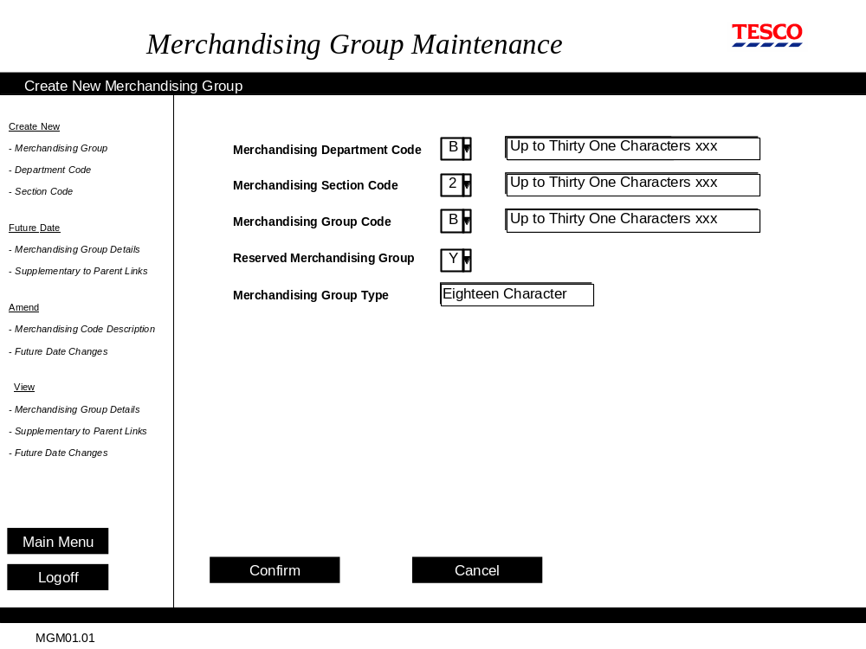
Display Group Maintenance Screens

Slide 10
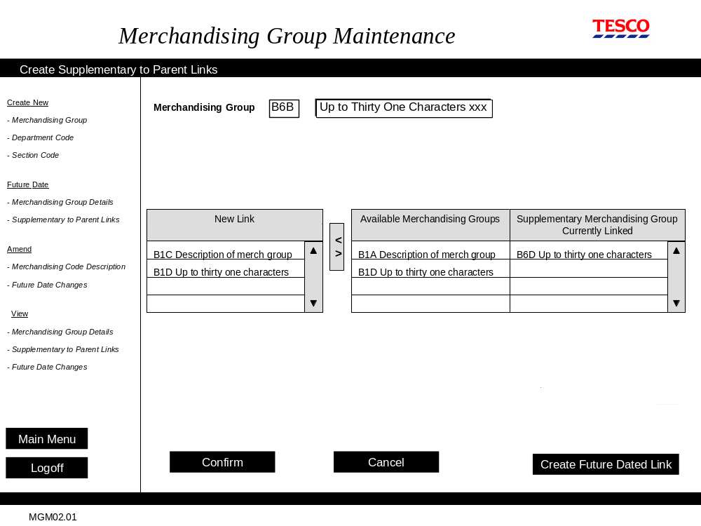
Display Group Maintenance Screens

Slide 11
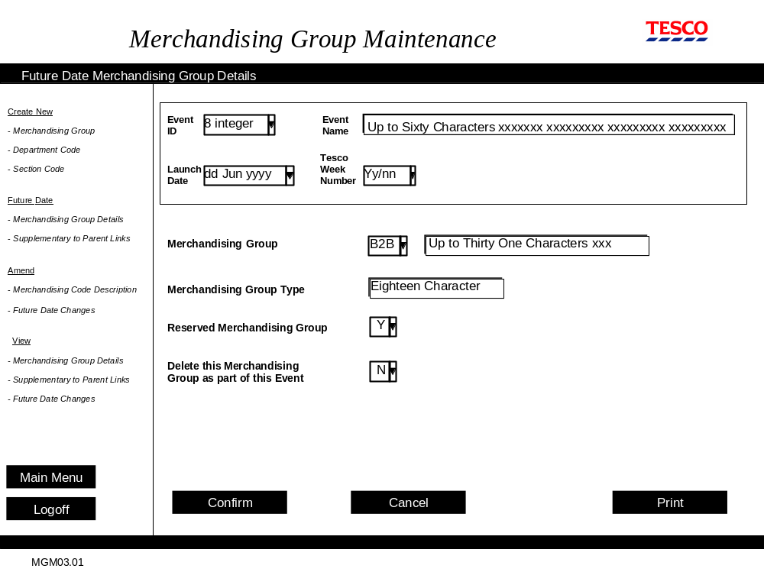
Display Group Maintenance Screens

Slide 12
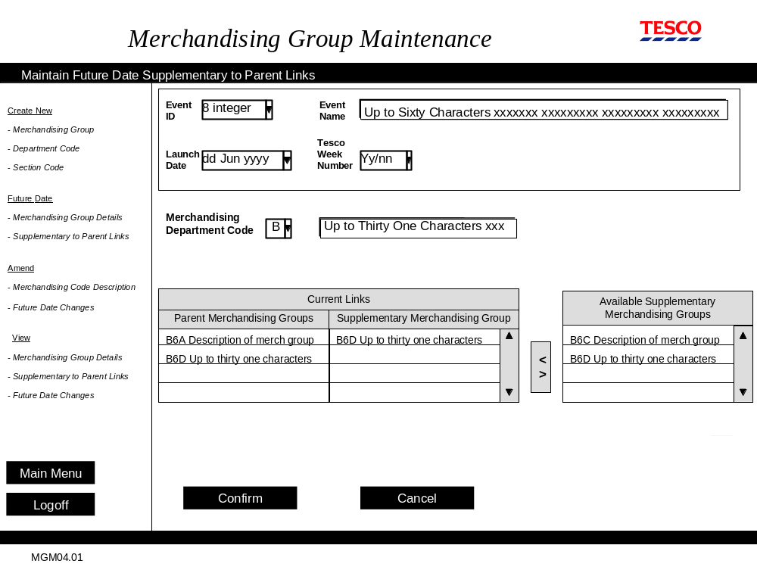
Display Group Maintenance Screens

Slide 13
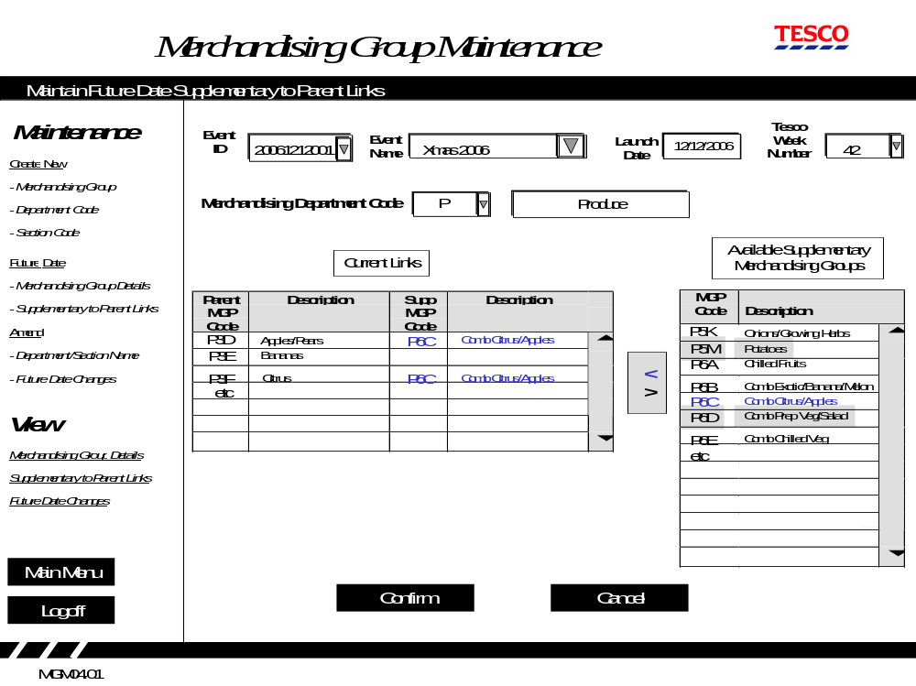
Display Group Maintenance Screens

Slide 14
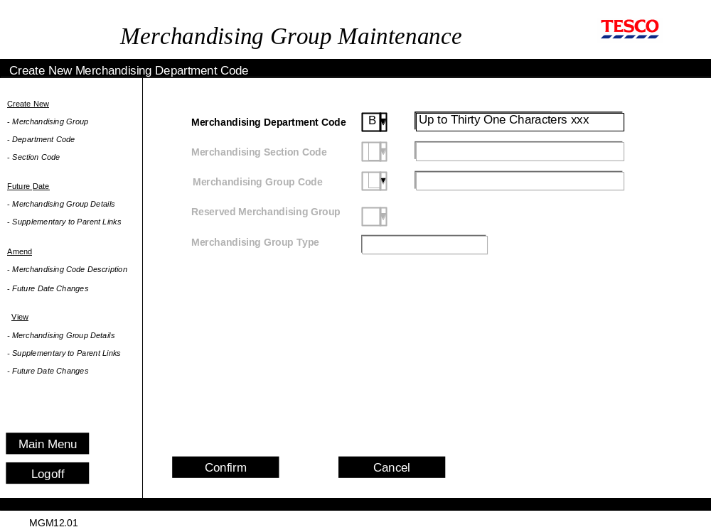
Display Group Maintenance Screens

Slide 15
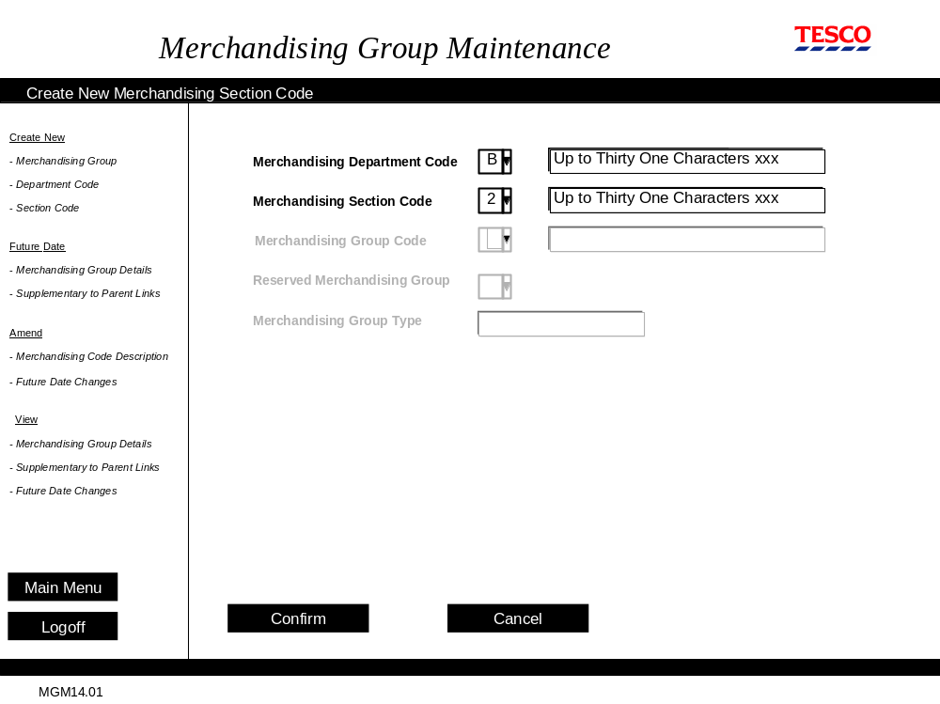
Display Group Maintenance Screens

Slide 16
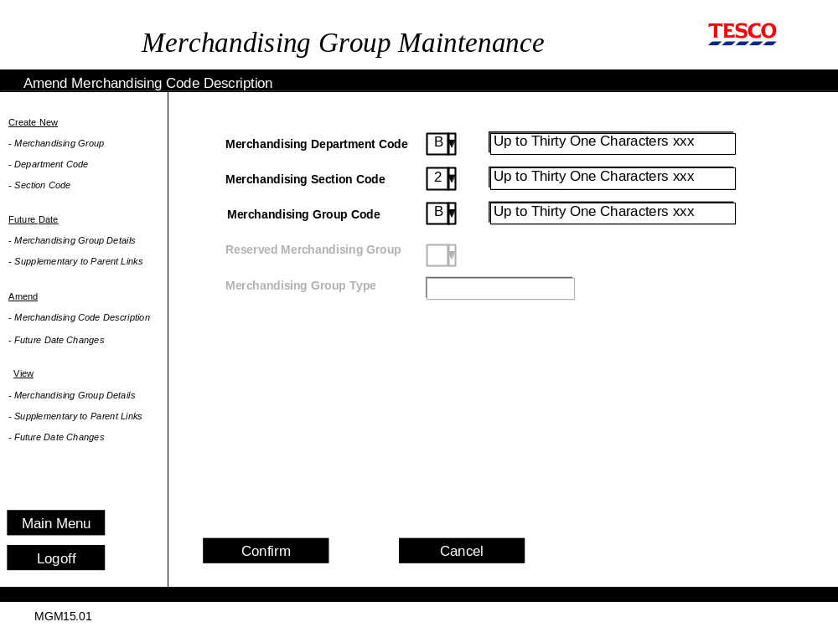
Display Group Maintenance Screens

Slide 17
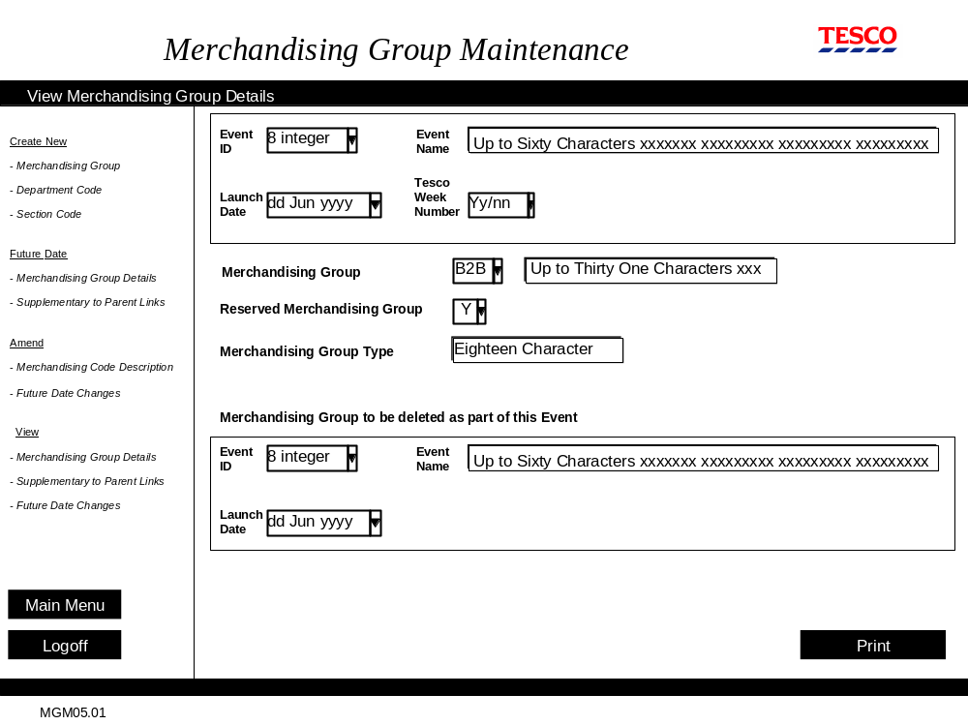
Display Group Maintenance Screens

Slide 18
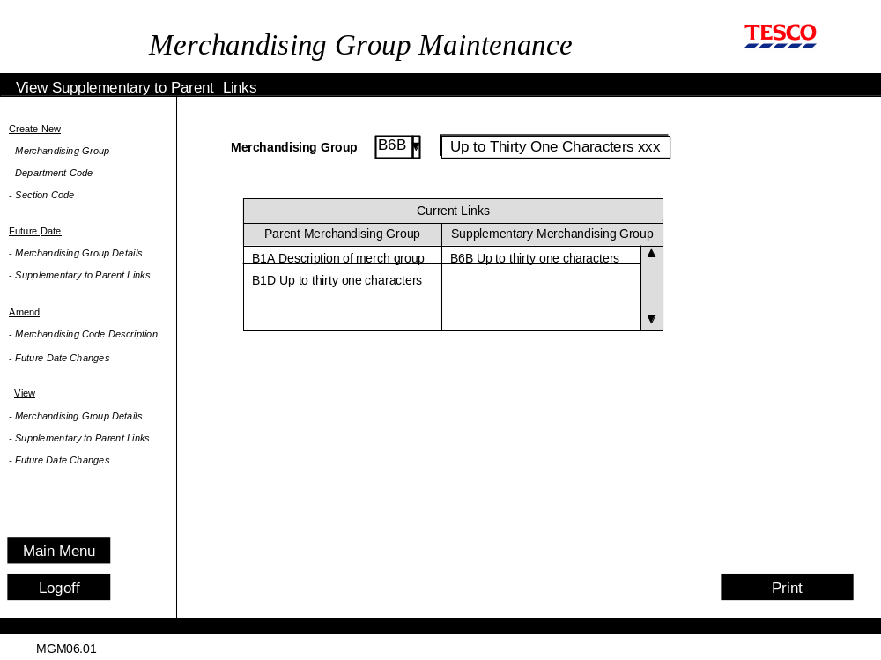
Display Group Maintenance Screens

Slide 19
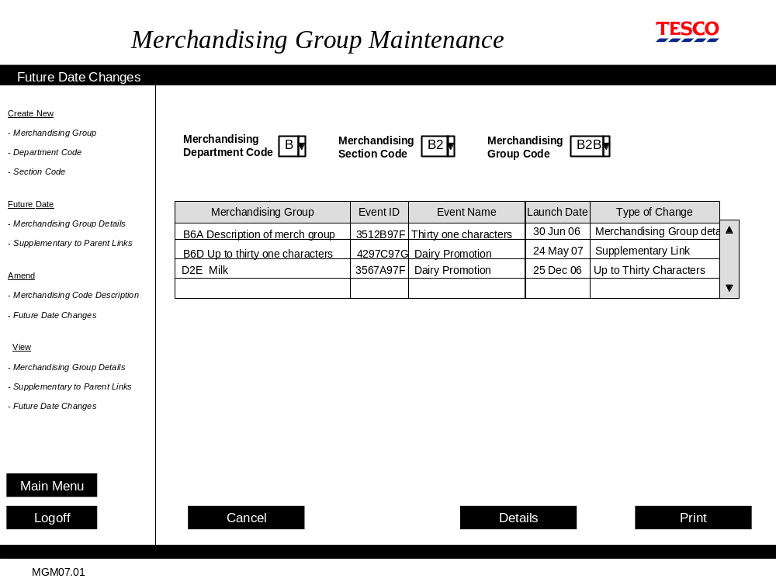
Display Group Maintenance Screens

Slide 20
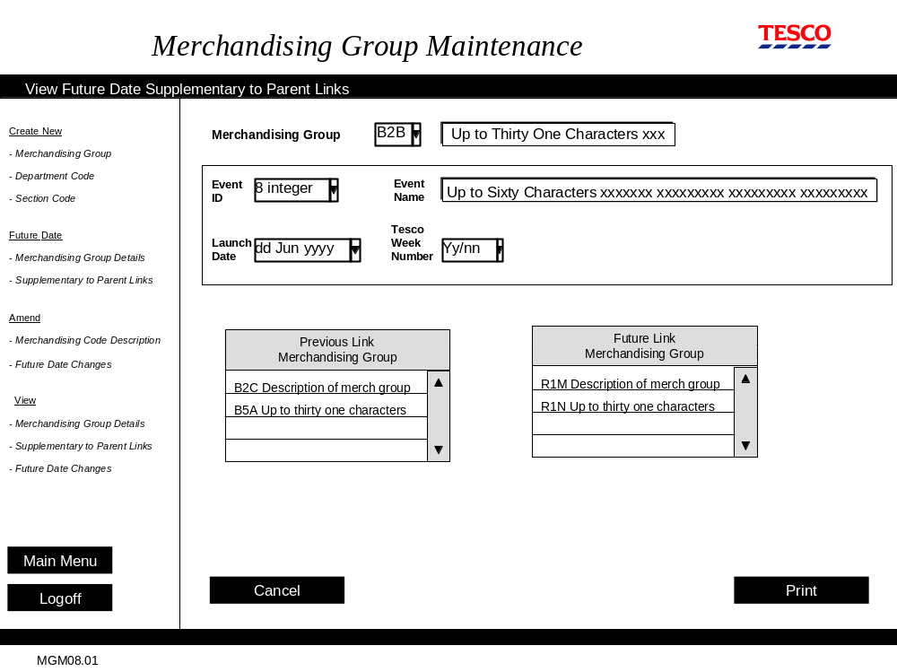
Display Group Maintenance Screens

Slide 21
SRD Schedule Secession Summary
What is Display Group
What is display group Maintenance
Why Display Group Maintenance
Basic Architecture
Display Group Maintenance and Events
Display Hierarchy
Flexible Display Hierarchy
Business Process
Display Group Maintenance Screen shots
  Create New Display Group
  Create Supplementary to Parent Link
  Future date Display Group Details
  Maintain Future date for Supp to Parent Links
  Create new Display Department Code
  Create new Display Section Code
  Amend Display Code description
  View Display Group details
  View Supp to Parent Links
  Future date changes
  View Future date Supp to Parent Links

Slide 22
Thank You..!!

